Slide 1
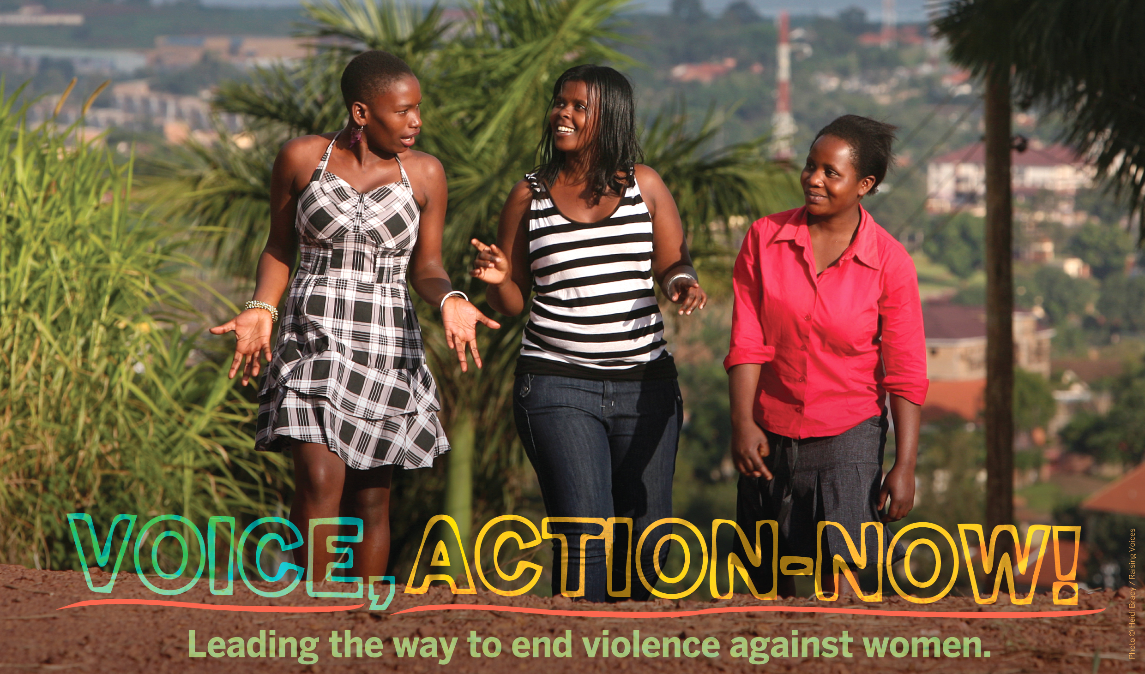
16 Days of Activism
Regional Campaign 2015

Slide 2
Violence Against Women (VAW)
Is any act of gender-based violence that results in, or is likely to result in, physical, sexual or mental harm or suffering to women, including threats of such acts, coercion or arbitrary deprivation of liberty, whether occurring in public or in private life
http://www.who.int/mediacentre/factsheets/fs239/en/
1

Slide 3
Magnitude of Violence Against Women and Girls (VAWG)
1 in 3 women globally will experience physical or/ and sexual violence from a intimate partner (WHO)
In Sub Saharan African 36.6% of women experience physical or/ and sexual violence from an intimate partner
(Insert national statistics here please)
2

Slide 4
Consequence and Cost of VAWG
There are multiple consequences of violence, having immediate, short-term and long-term effects. They impact the individual, family, community and wider society, which translate into costs at the national, regional and international level
3

Slide 5
Consequences and costs of VAWG
VAWG reduces productivity and drains public budgets
VAWG deprives girls and young women from education (insert relevant national statistics)
VAWG fuels the HIV pandemic
(insert relevant national statistics)
4

Slide 6
Why Address VAWG
Because it’s everyone’s right to live free of violence
Fulfill regional and global commitments made to uphold the dignity and rights of every citizen in relation
To save costs at individual, family, community and national level
To encourage equal participation of girl and boys, women and men in education and political sphere
Boost social and economic development
5

Slide 7
Legal and Operational Frameworks
Our country is signatory to the following legal and operational frameworks listed below. This signals the country’s commitment to ending VAW:
(please insert international, and regional legal and operational frameworks that apply to your county)
6

Slide 8
Our Leadership to end VAWG
In this section please find out and include the following information
Provisions within your national constitution around gender equality. If there are none point this out as well
Check for and include provisions in the country’s laws that address violence against women. If there are none point this out as well
Include any other policies and national plans within the country that address violence against women If there are none point this out as well
Check for and include progress in implementing the above mentioned laws and policies
Check for and include gaps in implementation i.e. absence of operational plans, insufficient budgets, lack of knowledge and skills within implementing institutions etc
7

Slide 9
Take Action! – Leading the Way to end VAWG
Insert your specific campaign asks ideally they should be the campaign objectives and specific asks that you as a team agreed on as you completed the worksheet in the Action and Advocacy Kit before you commenced this campaign
8

Slide 10
Leading the Way to end VAWG
Everyone can and must end violence against women
Show your leadership – use your voice to condemn VAW, and take action for effective prevention and response now!
9

